Slide 1

Introducing PyCaret
July 17, 2020

Slide 2





About me
Data Analytics Leader by day and passionate Data Scientist by night
Active open-source contributor
Member of CPA, CMA, Canada and ACMA, UK, CGMA
Lived and worked in Asia, Middle East, East Africa, North America
Currently based in Toronto, Canada
https://www.linkedin.com/in/profile-moez/
https://medium.com/@moez_62905/
https://twitter.com/moezpycaretorg1
moez@pycaret.org

Slide 3
Important Links
Official : https://www.pycaret.org
PyCaret GitHub : https://www.github.com/pycaret/pycaret
LinkedIn : https://www.linkedin.com/company/pycaret
YouTube : https://www.youtube.com/channel/UCxA1YTYJ9BEeo50lxyI_B3g
Medium : https://medium.com/@moez_62905/
Today’s Presentation and Demo : https://www.github.com/pycaret/pycaret-demo-at
Follow hashtag #pycaret on LinkedIn and Twitter

Slide 4
Agenda
What is PyCaret?
Demo using PyCaret 1.0x
New Features in PyCaret 2.0x
Feature Demo using pycaret-nightly
Q&A

Slide 5



What is PyCaret?
PyCaret is an open source, low-code machine learning library in Python that aims to reduce the cycle time from hypothesis to insights. PyCaret can be used for rapidly developing and deploying machine learning pipeline.
EASY TO USE
PRODUCTIVITY TOOL
BUSINESS READY

Slide 6
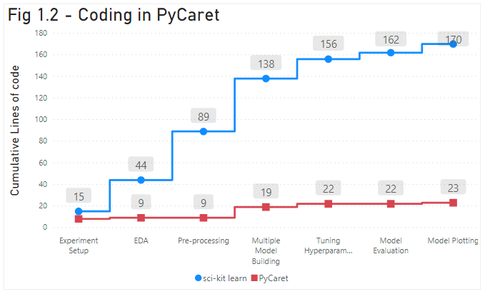
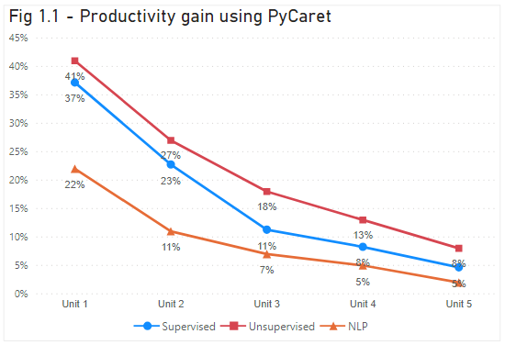
Effect of using PyCaret

Slide 7
Facts
Started in summer of 2019
Written in Python. Future versions may include wrappers in other langs.
Project took approximately 1 year to complete.
Self-funded so far.
Supported by team of brilliant people. To contribute please visit https://www.pycaret.org/contribute

Slide 8

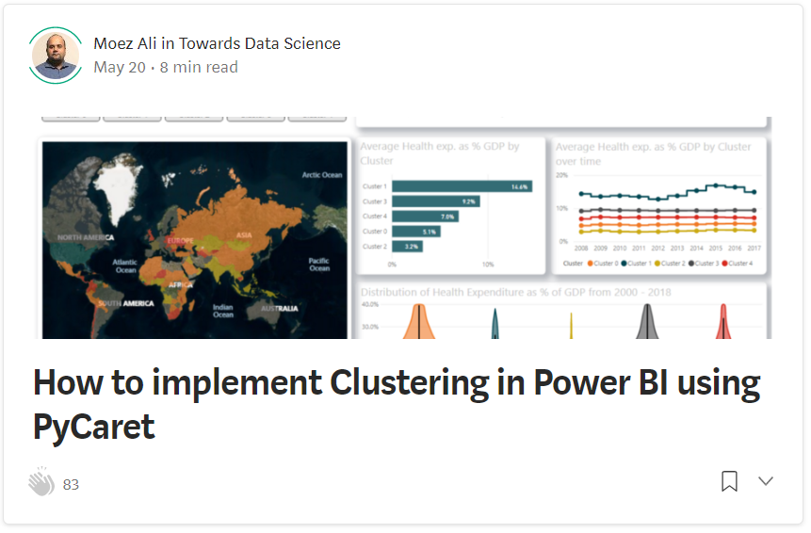
Resources
https://towardsdatascience.com/deploy-machine-learning-model-on-google-kubernetes-engine-94daac85108b
https://towardsdatascience.com/how-to-implement-clustering-in-power-bi-using-pycaret-4b5e34b1405b

Slide 9
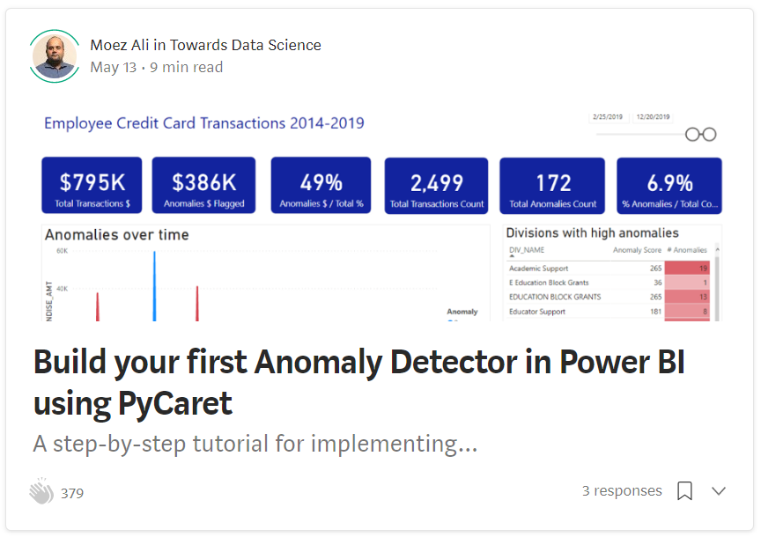
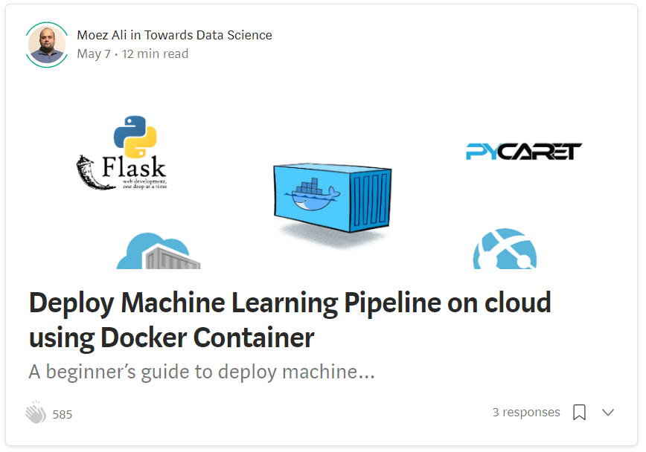
Resources (cont.)
https://towardsdatascience.com/build-your-first-anomaly-detector-in-power-bi-using-pycaret-2b41b363244e
https://towardsdatascience.com/deploy-machine-learning-pipeline-on-cloud-using-docker-container-bec64458dc01

Slide 10
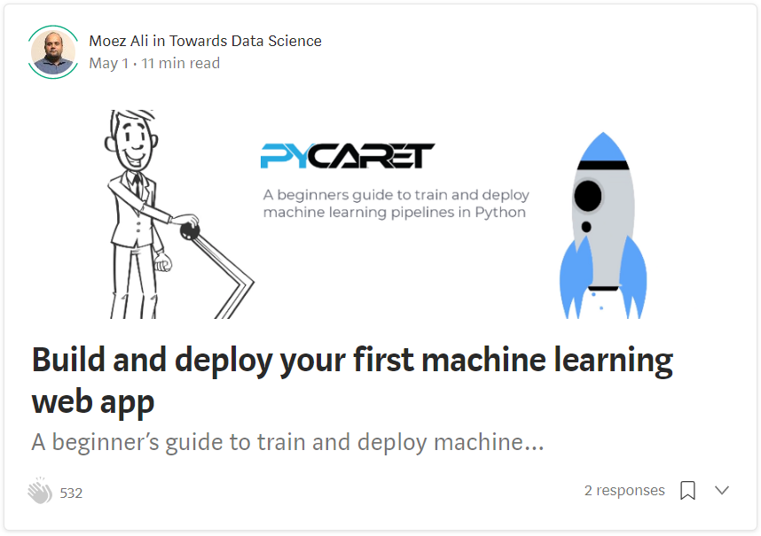

Resources (cont.)
https://towardsdatascience.com/build-and-deploy-your-first-machine-learning-web-app-e020db344a99
https://towardsdatascience.com/machine-learning-in-power-bi-using-pycaret-34307f09394a

Slide 11
Resources (cont.) – Official Video Tutorials
Binary Classification Video Tutorial
https://www.youtube.com/watch?v=2xAgLKUN6Xs
Clustering in PyCaret Video Tutorial
https://www.youtube.com/watch?v=2oxLDir7foQ
Anomaly Detection in PyCaret Video Tutorial
https://www.youtube.com/watch?v=q0dxYDq1A40&t=2s
Topic Modeling in PyCaret Video Tutorial
https://www.youtube.com/watch?v=G6ShuoM3T1M
Association Rule Mining in PyCaret Video Tutorial
https://www.youtube.com/watch?v=XYAGwts5qGw

Slide 12
Resources (cont.)
Machine Learning in SQL by Umar Farooque
https://towardsdatascience.com/machine-learning-in-sql-using-pycaret-87aff377d90c
PyCaret’s integration with Tableau by Andrew Cowan-Nagora
https://towardsdatascience.com/machine-learning-in-tableau-with-pycaret-166ffac9b22e
NLP Classification using PyCaret by Prateek Baghel
https://towardsdatascience.com/predicting-crashes-in-gold-prices-using-machine-learning-5769f548496
Predict Gold Price Returns using PyCaret by Riazuddin Mohammad
https://towardsdatascience.com/machine-learning-to-predict-gold-price-returns-4bdb0506b132
Predict Crashes in Gold Price using PyCaret by Riazuddin Mohammad
https://towardsdatascience.com/predicting-crashes-in-gold-prices-using-machine-learning-5769f548496

Slide 13
Resources (cont.)
Binary Classification Notebook by Murali Tedla
https://colab.research.google.com/drive/1W6ZYw5oAN7V85utFkXkCQq3iBWjqP1WB
Wine Quality Prediction by Abhinav Arora
https://colab.research.google.com/drive/1uFNmhgM9ghVrtqN3MXaofxDlLePb3yIi#scrollTo=sYsHyY8uH6tb
Build your machine learning models by Lakshay Arora
https://www.analyticsvidhya.com/blog/2020/05/pycaret-machine-learning-model-seconds/
PyCaret’s Integration with Power BI (1 Hour Video Tutorial)
https://www.youtube.com/watch?v=ZeQVkEWo2x0
Anomaly Detection using PyCaret by Krish Naik (Video Tutorial)
https://www.youtube.com/watch?v=ZeQVkEWo2x0

Slide 14


Demo PyCaret 1.0x
Clone repository from https://github.com/pycaret/pycaret-demo-at
Install PyCaret by running "pip install pycaret" in Notebook or in Anaconda prompt
If you are using MAC OS, you might have to install LightGBM separately. Follow instructions on this link: https://www.pycaret.org/install
Links to demo notebook at https://www.pycaret.org/demo
You can also execute the notebook in playground mode by installing pycaret on colab by using "!pip install pycaret".
You must have a google account to use Google colab.

Slide 15
New Features in PyCaret 2.0x
Modular Automation
Behavior of compare_models
Behavior of tune_models
Customize parameters
NEW FUNCTION: automl
MLFlow logging back-end
NEW PARAMETER: log_experiment
NEW FUNCTION: get_logs
System logs automatically created
Command Line Support
Support outside Notebook environment
Execute as python scripts
Remote execution (for e.g. Kaggle Kernels)
Preprocessing
NEW PARAMETERS:
fix_imbalance
data_split_shuffle
folds_shuffle
remove_perfect_collinearity
Utility functions
pull function
models
get_logs
get_config
set_config

Slide 16
Thank you
Questions?

